Slide 1
CHAPTER Demand Relationships
6 among Goods

Slide 2
The Two-Good Case
How the quantity of x chosen might be affected by a decrease in the price of y
  Shifting the budget constraint outward
  The quantity of good y chosen has increased
  In (a), small substitution effect
    x and p_{y} move in opposite directions
  In (b), large substitution effect
    x and p_{y} move in the same direction

Slide 3
6.1 Differing Directions of Cross-Price Effects
Quantity of y
Quantity of y
I₁
I₁
y₁
y₁
y₀
U₁
y₀
U₁
U₀
I₀
I₀
U₀
Quantity of x
(a) Gross complements
Quantity of x
(b) Gross substitutes
x₀
x₁
x₁
x₀
The price of y has decreased. In (a), substitution effects are small; therefore, the quantity of x consumed increases along with y. Because ∂x/∂p_{y} < 0, x and y are gross complements.
The price of y has decreased. In (b), substitution effects are large; therefore, the quantity of x chosen decreases. Because ∂x/∂p_{y} > 0, x and y would be termed gross substitutes.

Slide 4
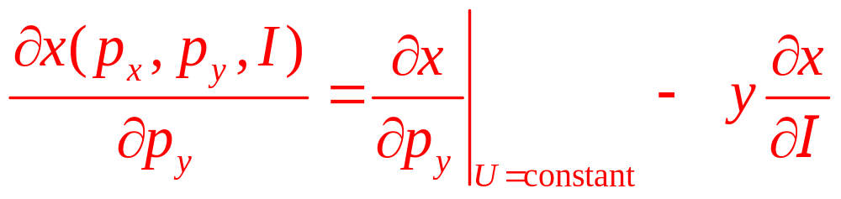
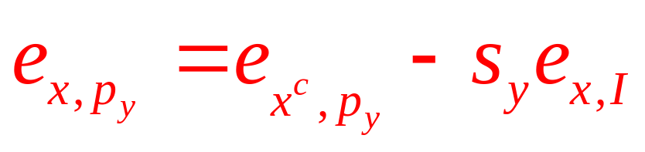
The Two-Good Case
Slutsky-type equation
Substitution effect (+)
Income effect (-) if x is normal
Combined effect (ambiguous)
In elasticity terms:

Slide 5
6.1 Another Slutsky Decomposition for
Cross-Price Effects
The cross-price effect of a change in y prices on x purchases
  Uncompensated demand function:
  x(p_{x},p_{y},I)=0.5 I/p_{x}
  Compensated demand function:
  x^{c}(p_{x},p_{y},V)=Vp_{y}^{0.5}p_{x}^{-0.5}
  Marshallian demand function in this case yields:
  ∂x/∂p_{y}=0

Slide 6
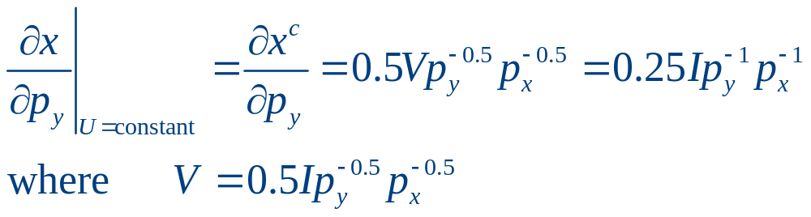
6.1 Another Slutsky Decomposition for
Cross-Price Effects
The cross-price effect of a change in y prices on x purchases
  Changes in the price of y do not affect x purchases
  Because the substitution and income effects of a price change are precisely counterbalancing
Substitution effect:

Slide 7
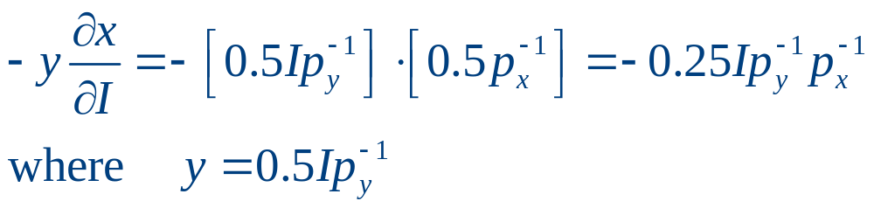
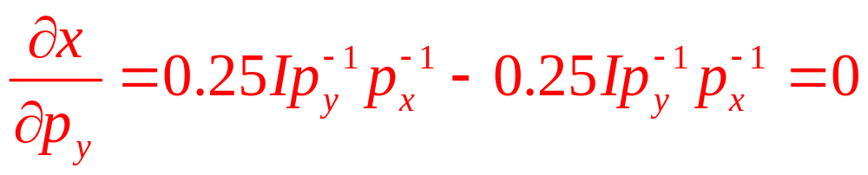
6.1 Another Slutsky Decomposition for
Cross-Price Effects
Income effect:
Total effect of a change in the price of y:

Slide 8
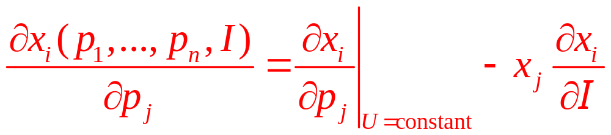
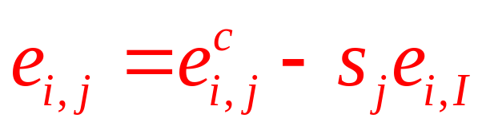
Substitutes and Complements
Many goods
  Generalize the Slutsky equation for any two goods x_{i}, x_{j}
  An elasticity relation

Slide 9
Substitutes and Complements
Substitutes
  If one good may, as a result of changed conditions, replace the other in use
  Substitute for one another in the utility function
Complements
  Goods that ‘‘go together’’
  Complement each other in the utility function

Slide 10
Substitutes and Complements
Gross substitutes
  Two goods, x_{i} and x_{j}, are said to be gross substitutes if: ∂x_{i}/∂p_{j}>0
  An increase in the price of one good causes more of the other good to be bought

Slide 11
Substitutes and Complements
Gross complements
  Two goods, x_{i} and x_{j}, are said to be gross complements if: ∂x_{i}/∂p_{j}<0
  An increase in the price of one good causes less of the other good to be purchased

Slide 12
Substitutes and Complements
Asymmetry of the gross definitions
  Gross definitions of substitutes and complements - are not symmetric
  It is possible, by the definitions
    For x₁ to be a substitute for x₂
    And at the same time
    For x₂ to be a complement of x₁

Slide 13
6.2 Asymmetry in Cross-Price Effects
Utility function, U(x,y) = ln x + y
  The Lagrangian, ℒ = ln x + y + λ(I – p_{x}x – p_{y}y)
  First-order conditions
∂ℒ /∂x = 1/x - λp_{x} = 0
∂ℒ /∂y = 1 - λp_{y} = 0
∂ℒ /∂λ = I - p_{x}x - p_{y}y = 0
  So, p_{x}x = p_{y}

Slide 14
6.2 Asymmetry in Cross-Price Effects
Substitution into the budget constraint
  Solve for the Marshallian demand function for y
  I=p_{x}x+p_{y}y = p_{y}+p_{y}y
  So, y=(I-p_{y})/p_{y}
  An increase in p_{y} - must decrease spending on y
    Because p_{x} and I are unchanged, spending on x must increase
      ∂x/∂p_{y}>0, gross substitutes
      ∂y/∂p_{x}=0, independent

Slide 15
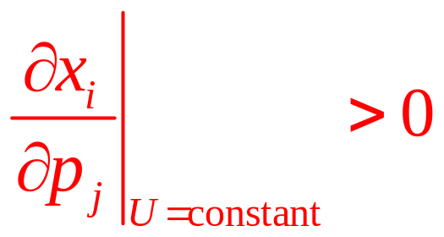

Net (Hicksian) Substitutes and Complements
Goods x_{i} and x_{j} are said to be net substitutes if:
Goods x_{i} and x_{j} are said to be net complements if:

Slide 16
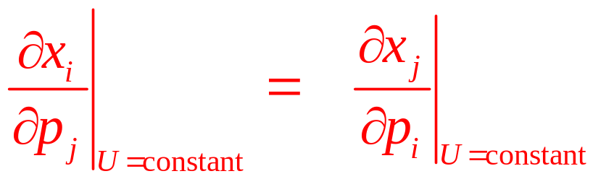
Net (Hicksian) Substitutes and Complements
These definitions
  Look only at the substitution terms to determine whether two goods are substitutes or complements
  Look only at the shape of the indifference curve
  This definition is unambiguous because the definitions are perfectly symmetric

Slide 17
Net (Hicksian) Substitutes and Complements
The difference between Hicks’ and Marshall’s definitions of substitutes and complements
  The Hicks definition eliminates the ambiguities
    Figure 6.1, Hicks substitutes, both graphs
  Marshall’s definition: income effects
    Figure 6.1a: Marshall complements
    Figure 6.1b: Marshall substitutes

Slide 18
Substitutability with Many Goods
Once the utility-maximizing model is extended to many goods
  A wide variety of demand patterns become possible
  Hicks’ second law of demand, “most” goods must be substitutes
    Start with the compensated demand function
      Homogenous of degree 0 in all prices
    Euler’s theorem
    Result – into elasticity terms

Slide 19
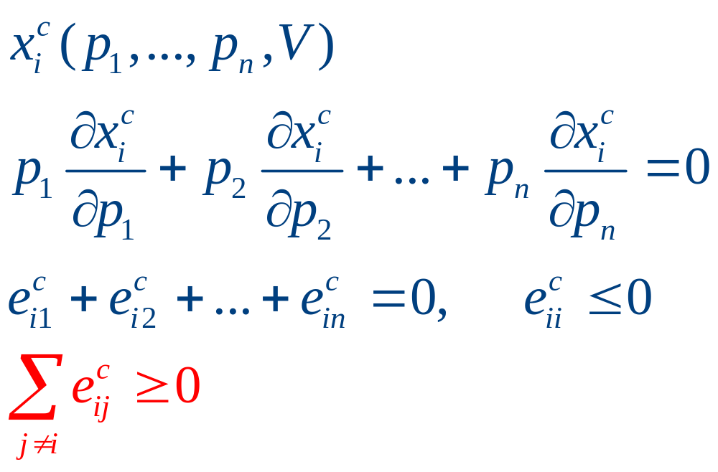
Substitutability with Many Goods
Proof:
  The sum of all the compensated cross-price elasticities for a particular good must be positive (or zero): ‘‘most’’ goods are substitutes

Slide 20
Composite Commodities
In the most general case
  An individual who consumes n goods
  Will have demand functions that reflect n(n+1)/2 different substitution effects
Convenience: group goods into larger aggregates
  Examples: food, clothing, “all other goods”

Slide 21
Composite Commodities
Consumers choose among n goods
  The demand for x₁ will depend on the prices of the other n-1 commodities
  Assuming that the prices of all of these other n-1 goods move proportionally together
    Composite commodity theorem: define a single composite of all of these goods, y
    Simpler problem of choosing only between x₁ and y

Slide 22
Composite Commodities
Consumers choose among n goods
  Let p₂⁰…p_{n}⁰ represent the initial prices of these other commodities
  Assume they all vary together (so that the relative prices of x₂…x_{n} do not change)

Slide 23
Composite Commodities
Define the composite commodity y
  To be total expenditures on x₂…x_{n} at the initial prices, y = p₂⁰x₂ + p₃⁰x₃ +…+ p_{n}⁰x_{n}
The individual’s budget constraint is
  I = p₁x₁ + p₂⁰x₂ +…+ p_{n}⁰x_{n} = p₁x₁ + y
  Assumption; all of the prices p₂⁰…p_{n}⁰ change in unison by a factor t (t > 0)

Slide 24
Composite Commodities
Budget constraint becomes
I = p₁x₁ + tp₂⁰x₂ +…+ tp_{n}⁰x_{n} = p₁x₁ + ty
  Changes in p₁ or t induce substitution effects
  As long as p₂⁰…p_{n}⁰ move together
    We can confine our examination of demand to choices between buying x₁ and “everything else”

Slide 25
Composite Commodities
A composite commodity
  A group of goods for which all prices move together
    These goods can be treated as a single commodity
    The individual behaves as if he is choosing between other goods and spending on this entire composite group

Slide 26
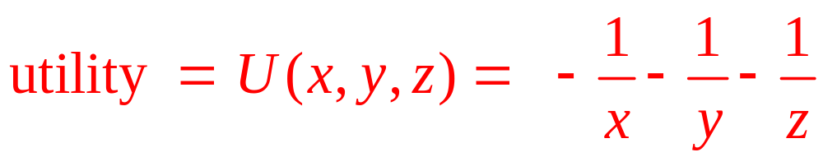
6.3 Housing Costs as a Composite
Commodity
Suppose that an individual receives utility from three goods:
  Food (x)
  Housing services (y), measured in hundreds of square feet
  Household operations (z), measured by electricity use
CES utility function

Slide 27
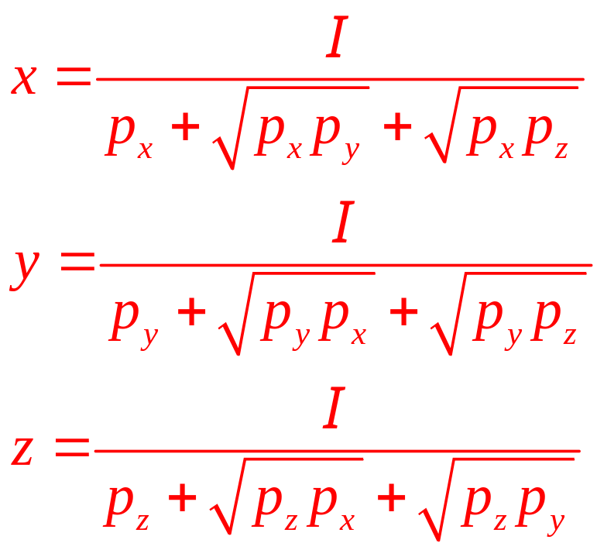
6.3 Housing Costs as a Composite
Commodity
Lagrangian technique
  Can be used to calculate Marshallian demand functions for these goods as

Slide 28
6.3 Housing Costs as a Composite
Commodity
If initially I = 100, p_{x} = 1, p_{y} = 4, p_{z} = 1
  Demand functions predict: x*= 25, y*= 12.5, z*= 25
  $25 is spent on food and $75 is spent on housing-related needs
Assume that the p_{y} and p_{z} move together
  Define the “composite commodity” housing (h)
  h = 4y + 1z
  Define the initial price of housing (p_{h}) to be 1
    Initial quantity of housing = total spent on housing (75)

Slide 29
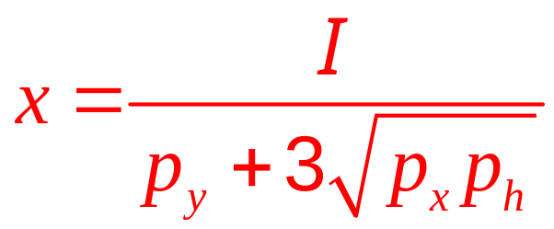
6.3 Housing Costs as a Composite
Commodity
p_{y} and p_{z} always move together
  p_{h} will always be related to these prices, p_{h}=p_{z}=0.25p_{y}
Recalculate the demand function for x as a function of I, p_{x}, and p_{h}:
  If I = 100, p_{x} = 1, p_{y} = 4, and p_{h} = 1, x* = 25
  p_{h} h* = I – p_{x}x* = 100-25 = 75. Since p_{h}=1, h* = 75

Slide 30
Home Production, Attributes of Goods, and Implicit Prices
Household production model
  Individuals do not receive utility directly from goods they purchase in the market
  Utility is received when the individual produces goods by combining market goods with time inputs

Slide 31
Home Production, Attributes of Goods, and Implicit Prices
Three goods: x, y, and z
  Purchasing these goods provides no direct utility
  Can be combined to produce either of two home-produced goods: a₁ or a₂
    The technology of this household production: production functions f₁ and f₂

Slide 32
Home Production, Attributes of Goods, and Implicit Prices
Choose x, y, and z as to maximize
  utility= U(a₁,a₂)
Subject to the production functions
  a₁=f₁(x,y,z)
  a₂=f₂(x,y,z)
And a financial budget constraint
  p_{x}x + p_{y}y + p_{z}z = I

Slide 33
Home Production, Attributes of Goods, and Implicit Prices
The production functions are measurable
  Households can be treated as “multi-product” firms
Consuming more a₁ requires more use of x, y, and z,
  This activity has an opportunity cost
  Measured in terms of the amount of a₂ that can be produced

Slide 34
Home Production, Attributes of Goods, and Implicit Prices
The linear attributes model
  The attributes of goods provide utility to individuals
  Each good has a fixed set of attributes
  Assumes that the production equations for a₁ and a₂ have the form
    a₁ = a_{x}¹x + a_{y}¹y + a_{z}¹z
    a₂ = a_{x}²x + a_{y}²y + a_{z}²z

Slide 35
Home Production, Attributes of Goods, and Implicit Prices
The linear attributes model
  If the individual spends all of his or her income on good x: x* = I/p_{x}
  That will yield
    a₁* = a_{x}¹x* = (a_{x}¹I)/p_{x}
    a₂* = a_{x}²x* = (a_{x}²I)/p_{x}

Slide 36
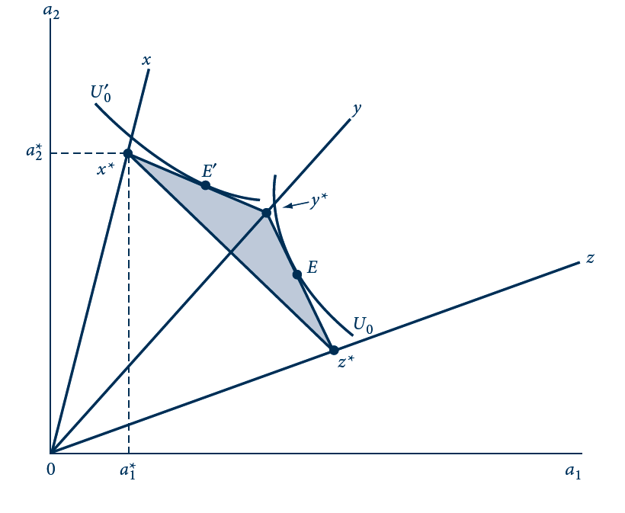
6.2 Utility Maximization in the Attributes Model
The points x*, y*, and z* show the amounts of attributes a₁ and a₂ that can be purchased by buying only x, y, or z, respectively. The shaded area shows all combinations that can be bought with mixed bundles. Some individuals may maximize utility at E, others at E’ .

Slide 37
Home Production, Attributes of Goods, and Implicit Prices
Corner solutions
  Will be relatively common
  Especially in cases where individuals attach value to fewer attributes than there are market goods to choose from
Consumption patterns may change abruptly if income, prices, or preferences change

Slide 38
Theory of two-stage budgeting
Partition of goods
  Into m nonoverlapping groups (r =1, m)
A separate budget (l_{r})
  Devoted to each category
Demand functions for the goods within any one category
  Depend on the prices of goods within the category
  And on the category’s budget allocation

Slide 39
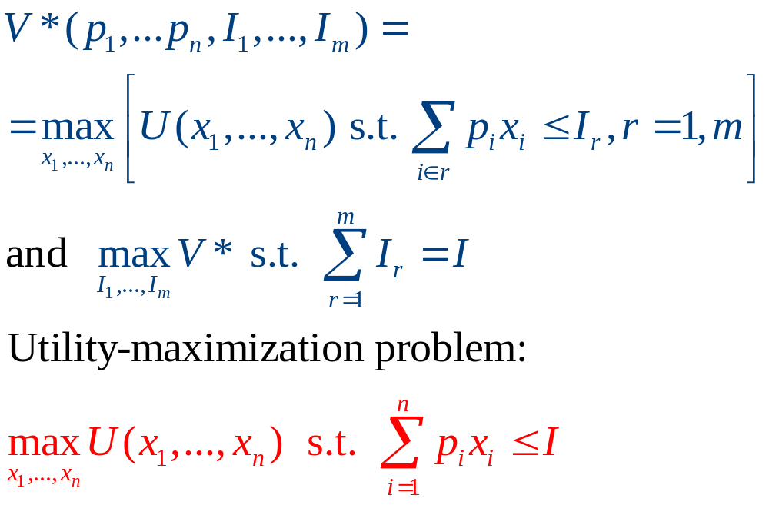
Theory of two-stage budgeting
Demand is given by:
  x_{i}(p₁,…p_{n},I)=x_{iЄr}(p_{iЄr},I_{r}), r=1,m

Slide 40
Relation to the composition commodity theorem
The composite commodity theorem
  Requires that the relative prices for goods within one group remain constant over time
    Assumption rejected during many different historical periods
Separability and two-stage budgeting
  Requires strong assumptions about how changes in prices for a good in one group affect spending on goods in any other group
    Assumptions rejected by the data

Slide 41
Relation to the composition commodity theorem
New elaborate, hybrid methods of aggregation among goods
  Composite commodity theorem might be generalized
  To cases where within-group relative prices exhibit considerable variability
  Much more accurate than assuming two-stage budgeting

Slide 42
Homothetic functions and energy demand
Assumption
  The utility for certain subcategories of goods is homothetic and may be separated from the demand for other commodities
Energy demand by U.S. consumers
  Assume demand functions for specific types of energy are proportional to total spending on energy
  Estimate the price elasticities of demand for various types of energy
    Fairly elastic demand functions

